Slide 1

First Steps with R in Life Sciences: Statistics
With slides from: Diana Marek, Geoffrey Fucile, Alex Smith, Linda Dib, Leonore Wigger, Wandrille Duchemin

Slide 2
Statistical hypothesis testing
Two hypotheses in competition:
H0: the NULL hypothesis (usually the most conservative – e.g., “no difference”)
H1: the alternative hypothesis (usually the one we are actually interested in)
Example:
H0: « There is no difference in weight between two given strains of mice »
H1: « The average weight in KO mice is different from that in WT mice »
Statistical test:
Calculate test statistic,
Calculate associated p-value,
Check if p-value is small enough to reject H0, according to pre-defined significance level.

Slide 3
t-test
Goal:
Compare a continuous measure between two groups
Is the difference between the two group means statistically significant?
Assumptions:
Observations are independent
The two groups follow a normal distribution
(Same variance in each group)
R uses Welch's t-test, which does not assume equal variance

Slide 4
Example data set: iris
Let's compare Iris virginica and Iris versicolor petal lengths.
data(iris)
# we limit the data to 2 species
iris_f = iris[ iris$Species %in% c('versicolor','virginica') , ]
iris_f$Species = factor(iris_f$Species)
tapply( iris_f$Petal.Length, iris_f$Species, mean )
versicolor virginica
4.260 5.552
plen_versicolor = iris_f$Petal.Length[iris_f$Species=='versicolor']
plen_virginica = iris_f$Petal.Length[iris_f$Species=='virginica']

Slide 5
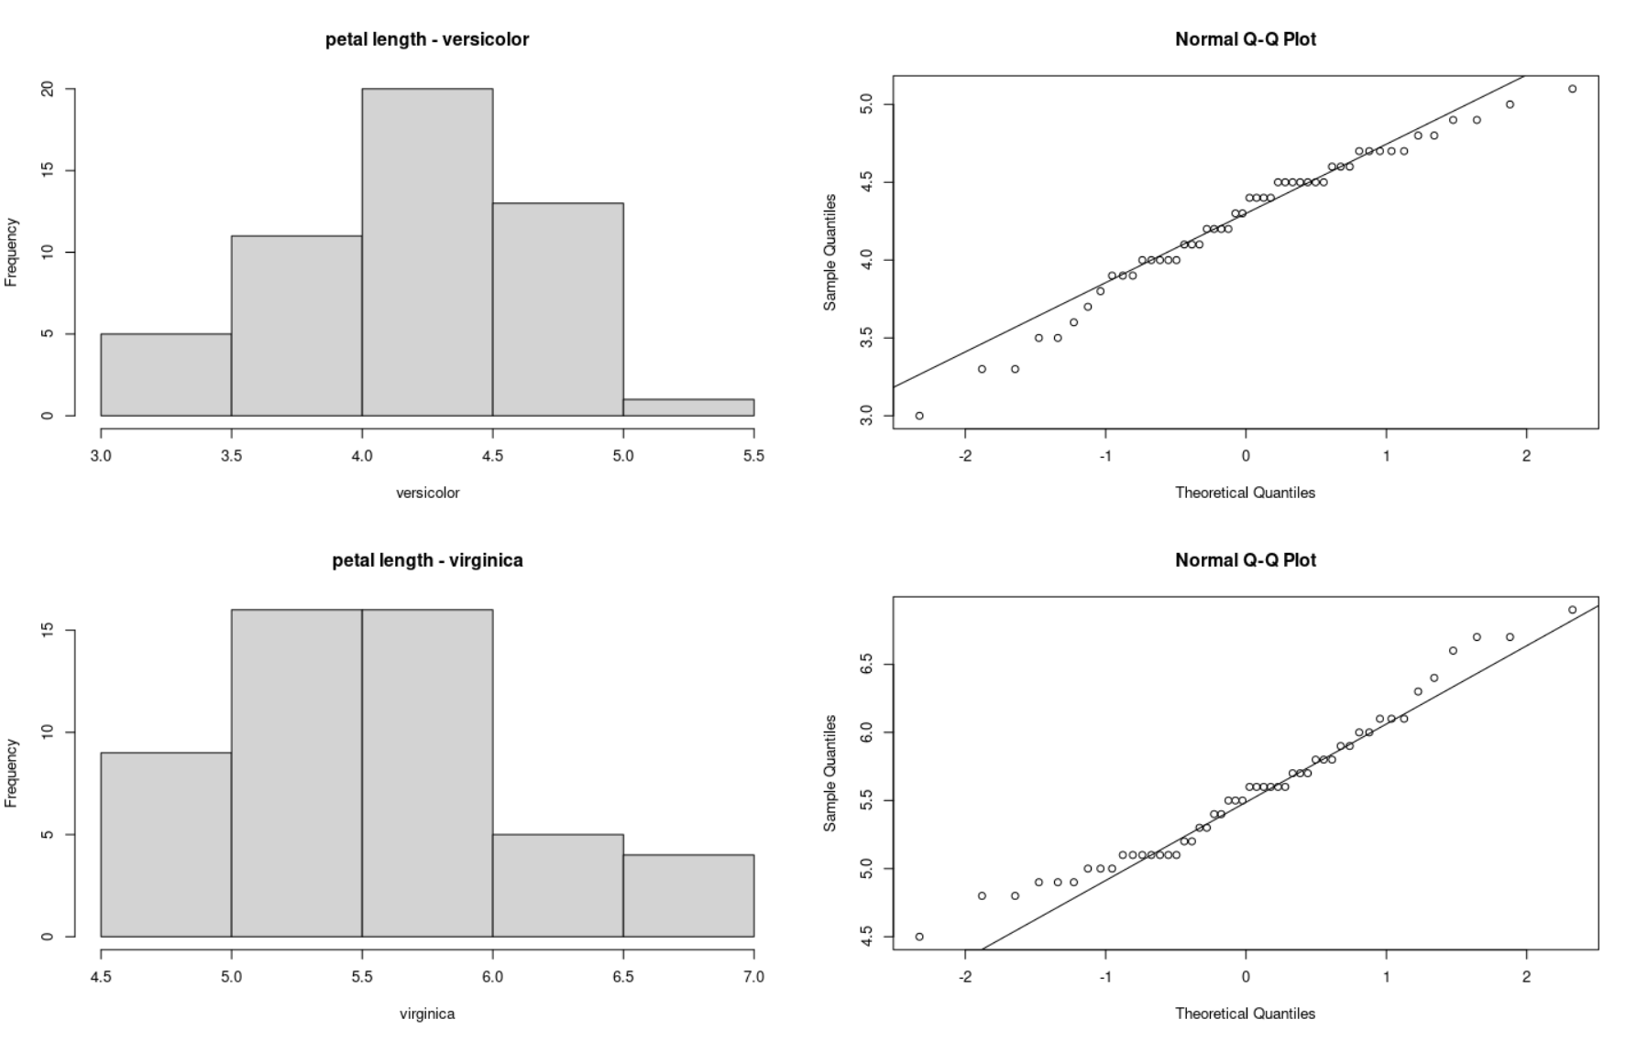
Check normality of the data with plots
We use histograms and QQplot to visually assess normality
par(mfrow=c(2,2))
hist(plen_versicolor,
xlab="versicolor",
main="petal length - versicolor")
qqnorm(plen_versicolor)
qqline(plen_versicolor)
hist(plen_virginica,
xlab="virginica",
main="petal length - virginica")
qqnorm(plen_virginica)
qqline(plen_virginica)
dev.off()

Slide 6
Check normality of the data with tests
We use the Shapiro-Wilks test, it is not ideal as the null hypothesis is normality (what we would like).
So, accepting normality has no type II error
control...
shapiro.test(plen_versicolor)
Shapiro-Wilk normality test
data: plen_versicolor
W = 0.966, p-value = 0.1585
shapiro.test(plen_virginica)
Shapiro-Wilk normality test
data: plen_virginica
W = 0.96219, p-value = 0.1098

Slide 7
Check normality of the data with tests
We use the Shapiro-Wilks test, it is not ideal as the null hypothesis is normality (what we would like).
So, accepting normality has no type II error
control...
shapiro.test(plen_versicolor)
Shapiro-Wilk normality test
data: plen_versicolor
W = 0.966, p-value = 0.1585
shapiro.test(plen_virginica)
Shapiro-Wilk normality test
data: plen_virginica
W = 0.96219, p-value = 0.1098
t-test is somewhat robust to non-normal data. No need to be too strict about normality requirement.

Slide 8
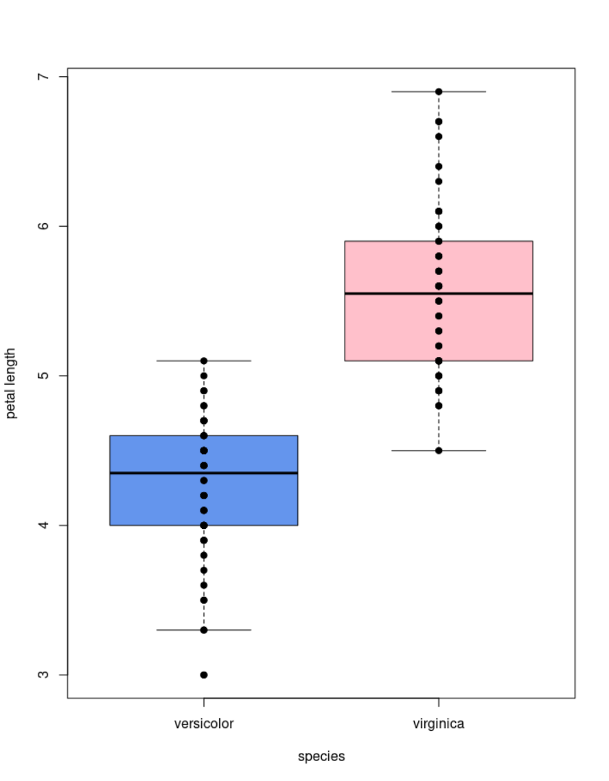
Visualize group differences
boxplot(Petal.Length ~ Species,
data=iris_f,
col=c("cornflowerblue", "pink"),
ylab="petal length",
xlab="species")
points( Petal.Length ~ Species,
data=iris_f,
col="black",
pch = 19)

Slide 9
Function t.test()
t.test(plen_versicolor, plen_virginica)
t.test(Petal.Length ~ Species, data=iris_f) #equivalent to the above
Welch Two Sample t-test
data: Petal.Length by Species
t = -12.604, df = 95.57, p-value < 2.2e-16
alternative hypothesis: true difference in means between group versicolor and group virginica is not equal to 0
95 percent confidence interval:
-1.49549 -1.08851
sample estimates:
mean in group versicolor mean in group virginica
4.260 5.552

Slide 10
t.test object
t.test() and other tests return a list that can be assigned to a variable.
View the names of the list’s slots using names().
Access the elements of a list using the $ or the [[ ]] operators.
test_res = t.test(Petal.Length ~ Species, data=iris_f)
names(test_res)
[1] "statistic" "parameter" "p.value" "conf.int" "estimate"
[6] "null.value" "stderr" "alternative" "method" "data.name"
test_res[['p.value']]
[1] 4.900288e-22

Slide 11
Paired data
When the measurements correspond to 2 observations on the same individuals, we need to use the paired t-test.
This tests focuses on the difference between the two observations and asks if the mean of this difference is different from 0.
Assumption: the sample mean of the differences are normally distributed

Slide 12
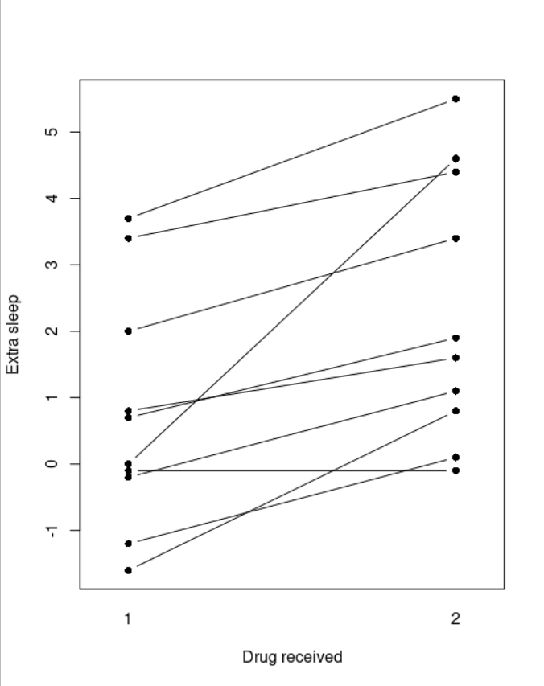
Paired data representation
data(sleep)
head(sleep, n=3)
extra group ID
1 0.7 1 1
2 -1.6 1 2
3 -0.2 1 3
interaction.plot(response=sleep$extra,
x.factor=sleep$group,
trace.factor=sleep$ID,
legend=FALSE, type="b",
lty=1, pch=16,
xlab="Drug received",
ylab="Extra sleep")

Slide 13
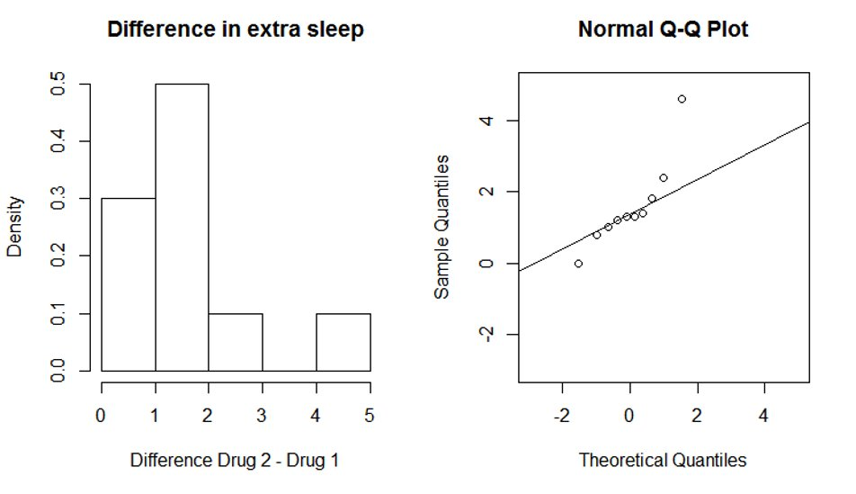
Check normality of the differences between pairs
difference = sleep$extra[sleep$group==2]-sleep$extra[sleep$group==1]
hist(difference, freq=FALSE, xlab="Difference Drug 2 - Drug 1",
main="Difference in extra sleep", col="white")
qqnorm(difference)
qqline(difference)

Slide 14
Paired t-test
# using a paired t-test:
t.test(sleep$extra[sleep$group==1],
sleep$extra[sleep$group==2], paired=TRUE)
# paired values must be at the same position in the two vectors
# do not use formula notation (extra~sleep) for paired t-test
Paired t-test
data: sleep$extra[sleep$group == 1] and sleep$extra[sleep$group == 2]
t = -4.0621, df = 9, p-value = 0.002833
alternative hypothesis: true difference in means is not equal to 0
95 percent confidence interval:
-2.4598858 -0.7001142
sample estimates:
mean of the differences
-1.58

Slide 15
Non-parametric alternatives to the t-test
When the data deviates strongly from normality, a non-parametric test can be used in place of a t-test.
Non-parametric tests do not assume any particular distribution of the data.
Instead of t-test (without pairing), use Mann-Whitney U test.
wilcox.test(sleep$extra[sleep$group==1],
sleep$extra[sleep$group==2])
wilcox.test(extra~group, data=sleep) # equivalent
Instead of paired t-test, use Wilcoxon Signed Rank test.
wilcox.test(sleep$extra[sleep$group==1],
sleep$extra[sleep$group==2], paired=TRUE)
These two tests have different names but are both implemented in the R function wilcox.test.

Slide 16
wilcox.test()
For the sleep data, a paired test is appropriate.
wilcox.test(sleep$extra[sleep$group==1],
sleep$extra[sleep$group==2], paired=TRUE)
Wilcoxon signed rank test with continuity correction
data: sleep$extra[sleep$group==1] and sleep$extra[sleep$group==2]
V = 0, p-value = 0.009091
alternative hypothesis: true location shift is not equal to 0
The conclusion is the same as it was for the paired t-test.
The p-value is a little higher wilcox.test: 0.009091 (t.test: 0.002833)

Slide 17
wilcox.test() - warning messages
wilcox.test() implements two ways to compute p-values: exact and by approximation
The method can be selected with parameter exact=TRUE or exact=FALSE
The default is "exact" if sample size < 50 and there are no ties in the data.
Otherwise, it is by normal approximation.
Warning messages:
1: In wilcox.test.default(sleep$extra[sleep$group == 1], sleep$extra[sleep$group == :
cannot compute exact p-value with ties
2: In wilcox.test.default(sleep$extra[sleep$group == 1], sleep$extra[sleep$group == :
cannot compute exact p-value with zeroes
These warnings don't mean that there is an error in the result. An (approximated) p-value is still provided and can be reported.

Slide 18
Let's practice - 10
Come back to the mice data-set stored in the "mice_data" data frame.
Considering WT mice weight and KO mice weight separately, check the assumption of normality graphically.
Make an appropriate plot to visualize the mouse weights grouped by genotype.
Perform a test to see whether the mouse weight is different between the two genotypes.
Repeat steps 1 to 3 for the diet variable.
EXTRA TASKS:
Use the non-parametric alternative of the test on the same problem.
Test if the subgroups have equal variance using function var.test(). If it looks like they do, look up the t.test() documentation, see which option you can change, and try it out.

Slide 19
Bivariate linear correlation
Goal: Quantify the strength of a linear correlation between two continuous variables
cor() computes a correlation between two variables.
Default: method="pearson" (linear correlation)
Other options: method="spearman", method="kendall" (rank-based correlations)
cor.test()
computes a correlation and performs a corresponding statistical test
for Pearson correlation: p-value from linear regression, same as lm()

Slide 20
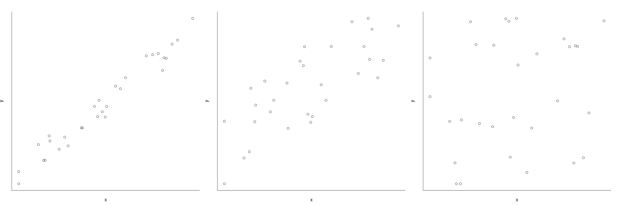

Visualization of linear correlation
Strong linear correlation
Medium-strong linear correlation
No correlation

Slide 21
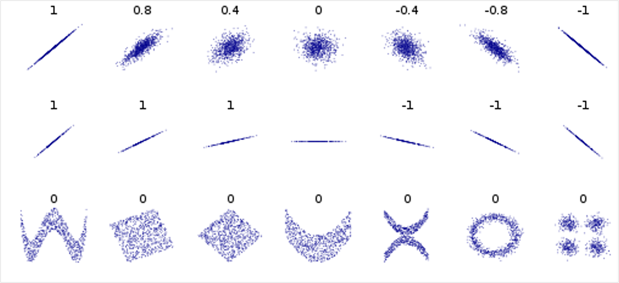
More vosialization of linear correlation
correlation reflects the noisiness and direction of a linear relationship (top row)
but not the slope of that relationship (middle)
nor many aspects of nonlinear relationships (bottom).
Image credit:
wikipedia user DenisBoigelot,
under the CC0 1.0 license

Slide 22
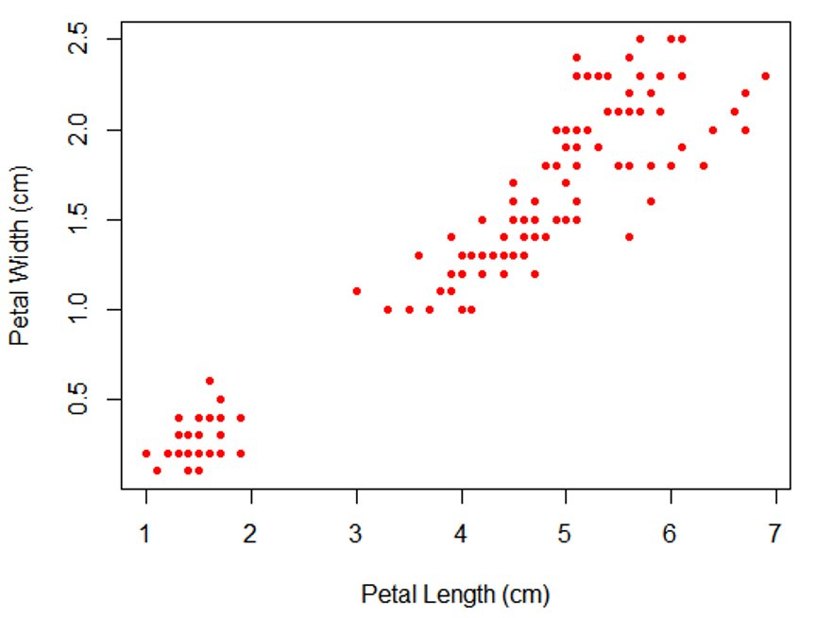
Scatter plot
plot(iris$Petal.Length, iris$Petal.Width,
col="red", pch=20,
xlab="Petal Length", ylab="Petal Width")

Slide 23
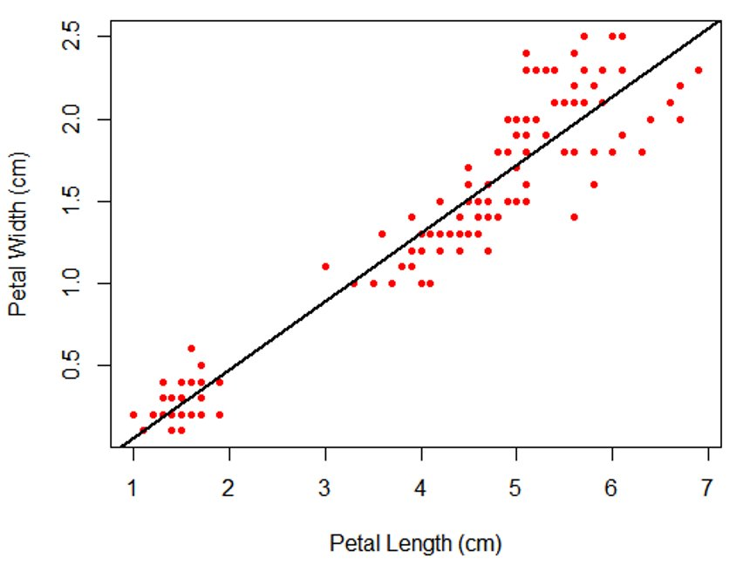
Scatter plot
plot(iris$Petal.Length, iris$Petal.Width,
col="red", pch=20,
xlab="Petal Length", ylab="Petal Width")
abline(lm(iris$Petal.Width~iris$Petal.Length),
col="black", lwd=2)

Slide 24
Linear correlation
cor(iris$Petal.Length, iris$Petal.Width, method="pearson")
[1] 0.9628654
cor.test(iris$Petal.Length, iris$Petal.Width, method="pearson")
Pearson's product-moment correlation
data: iris$Petal.Length and iris$Petal.Width
t = 43.387, df = 148, p-value < 2.2e-16
alternative hypothesis: true correlation is not equal to 0
95 percent confidence interval:
0.9490525 0.9729853
sample estimates:
cor
0.9628654

Slide 25
Linear regression
Goal: Determine the extent to which there is a linear relationship between an "outcome" variable (dependent variable) and one more "explanatory" variables (independent variables, predictor variables).
Can a significant part of the variability in the outcome be predicted/explained by the independent variables?
Outcome variable: continuous (e.g. weight, heart rate, blood sugar)
Explanatory variables: continuous or (with adaptations) categorical
In R, the linear regression model is specified by a model formula of the form:
outcome ~ explanatory variables

Slide 26
Simple linear regression
A simple regression model (one explanatory variable) is specified by
y = a + b*x+ err
a: Intercept
b: coefficient of explanatory var.
x: explanatory var.
err: error term (=residuals)
Assumptions :
Homoscedasticity : independence between residual variance and variables
Linearity + absence of linear relationship between predictor variables
independence of the observations.
Residuals centered around predicted value (mean=0)
+ normality of the residual’s mean
→ only used to assess parameters confidence interval
Otherwise : try log-transform (for heteroskedasticity) or non-parametric methods if the assumptions are not met.

Slide 27
Summary of the data
CLASS dataset, from the program SAS
(names removed and units have been modified from imperial to metric)
class_data <- read.csv("course_dataset/class.csv")
class_data$Gender=as.factor(class_data$Gender)
summary(class_data)
Gender Age Height Weight
F: 9 Min. :11.00 Min. :130.3 Min. :22.91
M:10 1st Qu.:12.00 1st Qu.:148.0 1st Qu.:38.22
Median :13.00 Median :159.5 Median :45.13
Mean :13.32 Mean :158.3 Mean :45.37
3rd Qu.:14.50 3rd Qu.:167.4 3rd Qu.:50.92
Max. :16.00 Max. :182.9 Max. :68.04

Slide 28
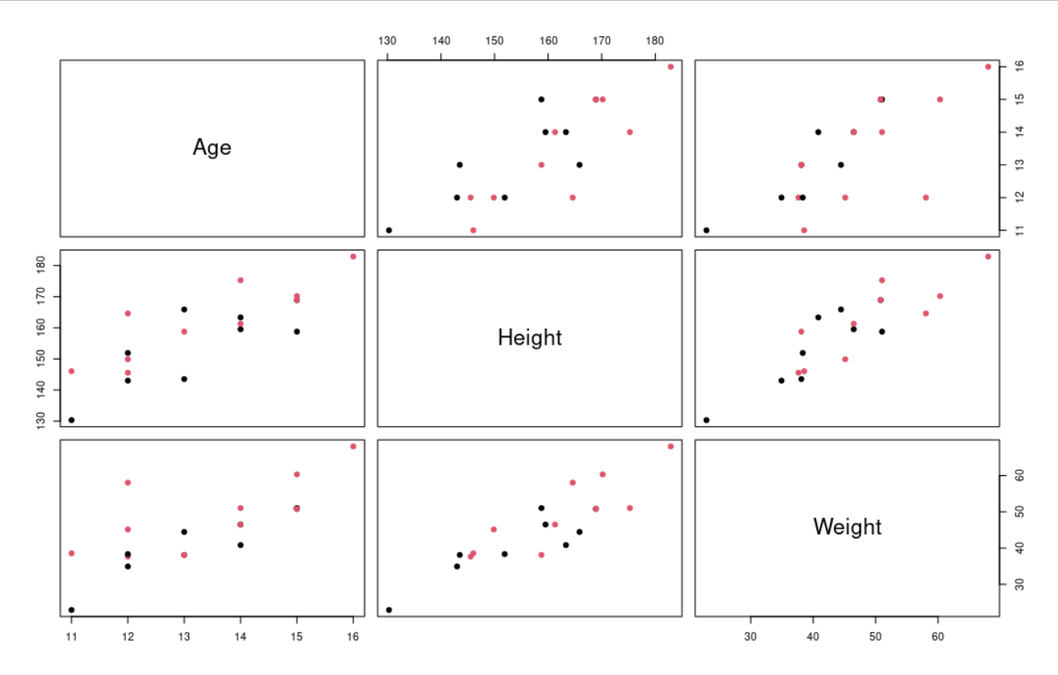
Visual summary of the data
pairs(class_data[2:4] , col = class_data$Gender,
pch=19 )

Slide 29
The lm() function
lm() : fits a linear model.
Creates an R object which contains the regression result
Just printing the result provides only the regression coefficients.
The summary() and plot() functions can be used to provide more information, including diagnostic plots.
Many other functions can be applied to the regression objects:
residuals() extracts a vector containing the residuals (error)
coef() extracts the regression coefficients
anova() produces the corresponding ANOVA table (not covered

Slide 30
Simple linear regression code
model_height_age <- lm(Height~Age, data=class_data)
model_height_age
Call:
lm(formula = Height ~ Age, data = class_data)
Coefficients:
(Intercept) Age
64.069 7.079

Slide 31
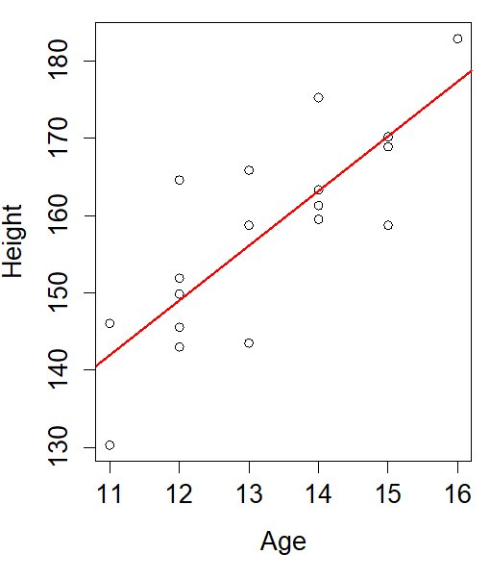
Representation of the fit (I)
plot(Height~Age,data=class_data)
abline(model_height_age, col="red", lwd=2)

Slide 32
Representation of the fit (II)
plot(Height~Age,data=class_data)
abline(model_height_age, col="red", lwd=2)
Coefficients: y-intercept and slope of the regression line
Coef(model_height_age)
(Intercept) Age
64.068667 7.079333

Slide 33
Representation of the fit (III)
Residuals: vertical distances of data points from the regression line
residuals(model_height_age)
1 2 3 4
-11.63933333 4.10866667 -3.47866667 2.87133333
5 6 7 8
0.83933333 -6.01866667 15.57133333 -12.59000000
9 10 11 12
9.76200000 2.65000000 -3.66733333 -1.88933333
13 14 15 16
12.08066667 0.14266667 -11.50866667 -1.34866667
17 18 19
-0.07866667 -1.34866667 5.54200000

Slide 34
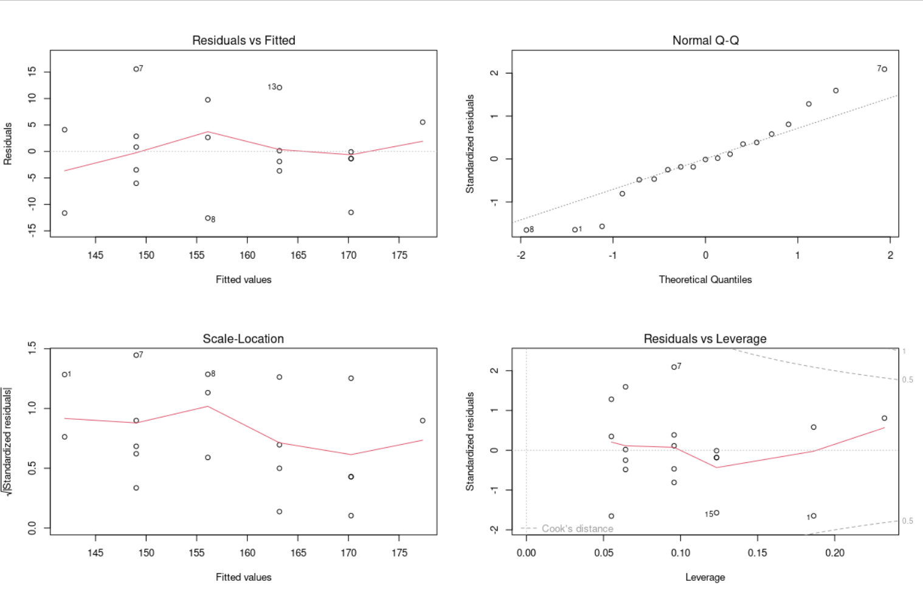
Check model assumptions
Commentaries on these plots:
https://library.virginia.edu/data/articles/diagnostic-plots
par(mfrow=c(2,2))
plot(model_height_age)

Slide 35
Check model assumptions
Commentaries on these plots:
https://library.virginia.edu/data/articles/diagnostic-plots
par(mfrow=c(2,2))
plot(model_height_age)
Residuals centered around 0
Normality of residuals
Homoskedascticity
Influence of points

Slide 36
Model summary
summary(model_height_age)
Call:
lm(formula = Height ~ Age, data = class_data)
Residuals:
Min 1Q Median 3Q Max
-12.5900 -3.5730 -0.0787 3.4900 15.5713
Coefficients:
Estimate Std. Error t value Pr(>|t|)
(Intercept) 64.069 16.565 3.868 0.00124 **
Age 7.079 1.237 5.724 2.48e-05 ***
---
Signif. codes: 0 ‘***’ 0.001 ‘**’ 0.01 ‘*’ 0.05 ‘.’ 0.1 ‘ ’ 1
Residual standard error: 7.832 on 17 degrees of freedom
Multiple R-squared: 0.6584, Adjusted R-squared: 0.6383
F-statistic: 32.77 on 1 and 17 DF, p-value: 2.48e-05

Slide 37
Model summary
summary(model_height_age)
Call:
lm(formula = Height ~ Age, data = class_data)
Residuals:
Min 1Q Median 3Q Max
-12.5900 -3.5730 -0.0787 3.4900 15.5713
Coefficients:
Estimate Std. Error t value Pr(>|t|)
(Intercept) 64.069 16.565 3.868 0.00124 **
Age 7.079 1.237 5.724 2.48e-05 ***
---
Signif. codes: 0 ‘***’ 0.001 ‘**’ 0.01 ‘*’ 0.05 ‘.’ 0.1 ‘ ’ 1
Residual standard error: 7.832 on 17 degrees of freedom
Multiple R-squared: 0.6584, Adjusted R-squared: 0.6383
F-statistic: 32.77 on 1 and 17 DF, p-value: 2.48e-05
Residuals: difference between observed and fitted
Parameter significance:
T-test
Residual normality assumption
R-squared : fraction of the variance explained by the model
F-test: does the model explain significantly more than a model with just the intercept?

Slide 38
Let's practice - 11
The data set "Pima" comes from a study on diabetes in women of Pima Indian heritage.
We are using a subset (Pima.tr).
Load the package MASS using library(). Load the dataset Pima.tr using data(Pima.tr). Use ? to get an idea which variables it contains.
Hypothesis: Blood glucose level (glu) is associated with diastolic blood pressure (bp). Run a linear model to test the hypothesis.
Visualize the fit with a scatter plot and a trend line.
Check assumptions of the model (homoscedasticity, mean of residual at 0, normality of the residuals) graphically.
EXTRA TASKS:
Look up in the next slides how you can run a muliple regression. Do the same for the Pima.tr data by adding a couple of covariables to the model.

Slide 39
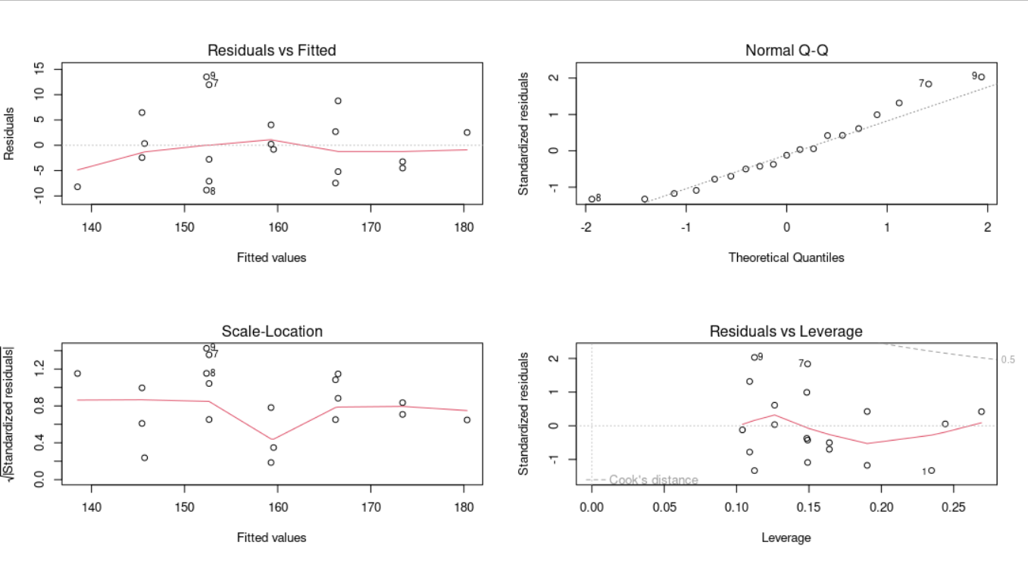
Additional content : model with 2 covariables (I)
model2 <- lm(Height~Age+Gender, data=class_data)
par(mfrow=c(2,2))
plot(model2)

Slide 40
Additional content : model with 2 covariables (II)
summary( model2 )
Call:
lm(formula = Height ~ Age + Gender, data = class_data)
Residuals:
Min 1Q Median 3Q Max
-8.8462 -4.8523 -0.8102 3.3677 13.5058
Coefficients:
Estimate Std. Error t value Pr(>|t|)
(Intercept) 62.291 14.957 4.165 0.000731 ***
Age 6.928 1.117 6.202 1.27e-05 ***
GenderM 7.204 3.251 2.216 0.041517 *
---
Signif. codes: 0 ‘***’ 0.001 ‘**’ 0.01 ‘*’ 0.05 ‘.’ 0.1 ‘ ’ 1
Residual standard error: 7.061 on 16 degrees of freedom
Multiple R-squared: 0.7387, Adjusted R-squared: 0.706
F-statistic: 22.61 on 2 and 16 DF, p-value: 2.176e-05

Slide 41
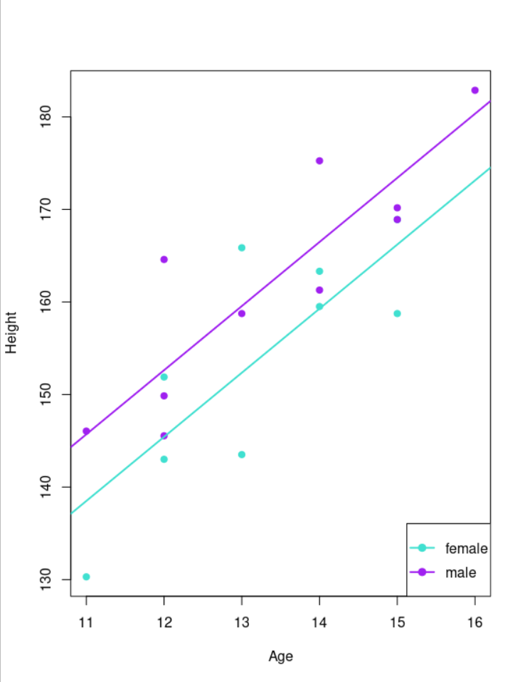
Additional content : model with 2 covariables (III)
plot( Height~Age,
col=c('turquoise','purple')[Gender],
pch=19, data=class_data )
C = coef( model2 )
abline(a=C[1],b=C[2] ,lwd=2,
col='turquoise')
abline(a=C[1]+C[3],b=C[2] lwd=2,
col='purple')
legend('bottomright',c('female','male'),
pch=19,lwd=2,
col=c('turquoise','purple'))

Slide 42
The next steps
R manuals: http://cran.r-project.org/manuals.html
free course material: https://glittr.org
STHDA (Statistical Tools for High Throughput Data Analysis) free tutorials: http://www.sthda.com/english/
Stackoverflow documentation, resources and user forum: http://stackoverflow.com/tags/r/info
Rseek - search engine on numerous online R resources: http://www.rseek.org

Slide 43
Credits and Acknowledgments
Content and slides developed by: Diana Marek, Geoffrey Fucile, Alex Smith, Linda Dib, Leonore Wigger, Wandrille Duchemin
Content inspired by material from:
Owen L. PETCHEY and “Getting started with R” book
Daniel WEGMANN and Frédéric SCHÜTZ
Robert STOJNIĆ and Ian ROBERTS
Jenny DRNEVICH
http://www.sib.swiss/training Any questions? Contact training@sib.swiss

Slide 44

Thank you
sib.swiss

